Slide 1
Multiplying Fractions
Prepared for grade 6
By Nada Farshoukh

Slide 2
TABLE OF CONTENTS
01
02
Fraction of a number
Fraction of a fraction
Multiplying fraction by a number
Multiplying fraction by a fraction

Slide 3
Fraction of a number
01
1
1
of
the cats
4
4
3 cats

Slide 4
Fraction of a number
Or
1
1
of
the cats
4
4

Slide 5
Fraction of a number
1
1
of
the cats
4
4
Or

Slide 6
Another example
3
of
this group
5
6 persons

Slide 7
Another example
3
of
this group
5

Slide 8
Another example
Or
3
of
this group
5
6 persons

Slide 9
Fraction of a number
2
2
of
the cars
3
3

Slide 10
Fraction of a number
Divide by denominator
Multiply by numerator
DDMN
2
of
the cars
3
2
12
×
3
12 ÷3 =4
×2 =8
DD
MN

Slide 11
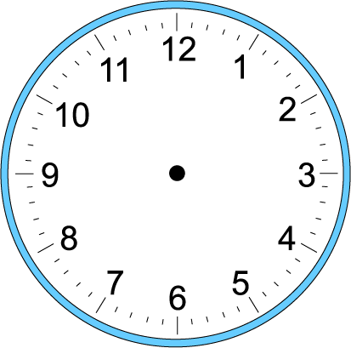
Fraction of a number
DDMN
3
3
of
an hour
4
4

Slide 12
Fraction of a number
DDMN
3
of
an hour
4
3
60
×
4
60 ÷4 =15
×3 =45
DD
MN

Slide 13
Fraction of a number
DDMN
2
2
of
an hour
3
3

Slide 14
Fraction of a number
DDMN
2
of
an hour
3
2
60
×
3
60 ÷3 =20
×2 =40
DD
MN

Slide 15
Remarkable fractions

Slide 16
1 cup
$\frac{1}{2}$ cup
1 cup
$\frac{1}{4}$ cup
$\frac{1}{4}$ cup
$\frac{1}{2}$ cup
$\frac{1}{4}$ cup
$\frac{1}{4}$ cup
1 cup
$\frac{1}{3}$ cup
$\frac{1}{3}$ cup
$\frac{1}{3}$ cup

Slide 17
Calculate the following
DDMN
$\frac{2}{5}$ × 50 =............................
$\frac{3}{4}$ × 24 =............................
$\frac{5}{8}$ ×32 =............................
50$÷$5=10$×$2=20
24$÷$4=6$×$3=18
32$÷$8=4$×$5=20

Slide 18
Calculate the following
DDMN
One third of an hour
$\frac{2}{3}$ × 60 =............................
$60÷3$=20$×$2=40 minutes
Two fifths of an hour
$\frac{2}{5}$ × 60 =............................
60$÷$5=12$×$2=24

Slide 19
Write a multiplication sentence to solve the following:
Ahmad received a 12-minute video. He watched five sixths of that video. How many minutes did he watch?
………………………………………………………………………………….......................................................
$\frac{5}{6}$ ×12=
12$÷$6=2$×$5=10
He watched 10 minutes of the video.

Slide 20
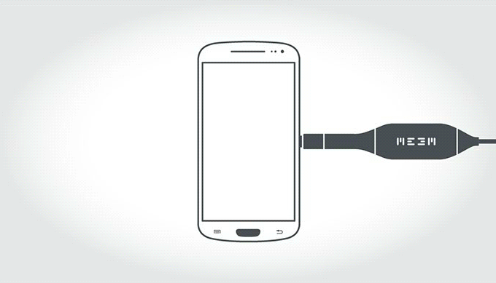
Write a multiplication sentence to solve the following:
DDMN
1. Rayan has a 64 GB phone memory. She uses three eighths of the memory for applications and one quarter of the memory for the pictures and videos.
How many GB are used for the Apps?
…………………………………………………………………………………………………………
b. How many GB are used for the pictures and videos?
…………………………………………………………………………………………………………
c. How many GB are left?
……………………………………………………………………………………………………………
$\frac{3}{8}$ ×64=
64$÷$8=8$×$3=24GB
$\frac{1}{4}$ ×64=
64$÷$4=16$×$1=16GB
64- (24+16) = 64-40=24GB

Slide 21
What if the number is not divisible by the denominator?

Slide 22
How much is one third of two cups?
1 cup
$\frac{1}{3}$ cup
$\frac{1}{3}$ cup
$\frac{1}{3}$ cup
1 cup
$\frac{1}{3}$ cup
$\frac{1}{3}$ cup
$\frac{1}{3}$ cup
$\frac{1}{3}$ cup
$\frac{1}{3}$ cup
2
3

Slide 23
How much is one third of five cups?
5
3
1 cup
1 cup
$\frac{1}{3}$ cup
$\frac{1}{3}$ cup
$\frac{1}{3}$ cup
$\frac{1}{3}$ cup
1 cup
$\frac{1}{3}$ cup
$\frac{1}{3}$ cup
1 cup
1 cup
$\frac{1}{3}$ cup
$\frac{1}{3}$ cup
$\frac{1}{3}$ cup
$\frac{1}{3}$ cup
$\frac{1}{3}$ cup
$\frac{1}{3}$ cup
$\frac{1}{3}$ cup
$\frac{1}{3}$ cup
$\frac{1}{3}$ cup
$\frac{1}{3}$ cup
$\frac{1}{3}$ cup
$\frac{1}{3}$ cup
$\frac{1}{3}$ cup
$\frac{1}{3}$ cup
$\frac{1}{3}$ cup
$\frac{1}{3}$ cup
$\frac{1}{3}$ cup
$\frac{1}{3}$ cup
$\frac{1}{3}$ cup

Slide 24
How much is one third of five cups?
5
3
$\frac{1}{3}$ cup
$\frac{1}{3}$ cup
$\frac{1}{3}$ cup
$\frac{1}{3}$ cup
$\frac{1}{3}$ cup

Slide 25
How much is one third of five cups?
1 cup
$\frac{1}{3}$ cup
$\frac{1}{3}$ cup
$\frac{1}{3}$ cup
$\frac{1}{3}$ cup
$\frac{1}{3}$ cup
5
3
2
2
+
=
1
=
3
3
3
3

Slide 26
What is two fifths of 2?
$$\frac{1}{5}$$
$$\frac{1}{5}$$
$$\frac{1}{5}$$
$$\frac{1}{5}$$
$$\frac{1}{5}$$
$$\frac{1}{5}$$
$$\frac{1}{5}$$
$$\frac{1}{5}$$
$$\frac{1}{5}$$
$$\frac{1}{5}$$
$$\frac{2}{5}×$$
2
=

Slide 27
What is two fifths of 2?
$$\frac{1}{5}$$
$$\frac{1}{5}$$
$$\frac{1}{5}$$
$$\frac{1}{5}$$
$$\frac{1}{5}$$
$$\frac{1}{5}$$
$$\frac{1}{5}$$
$$\frac{1}{5}$$
$$\frac{1}{5}$$
$$\frac{1}{5}$$
$$\frac{2}{5}×$$
2
=

Slide 28
What is two fifths of 2?
$$\frac{1}{5}$$
$$\frac{1}{5}$$
$$\frac{1}{5}$$
$$\frac{1}{5}$$
$$\frac{1}{5}$$
$$\frac{1}{5}$$
$$\frac{1}{5}$$
$$\frac{1}{5}$$
$$\frac{1}{5}$$
$$\frac{1}{5}$$
$$\frac{2}{5}×$$
$$\frac{4}{5}$$
2
=
1

Slide 29
What is three quarters of 5?
$$\frac{1}{4}$$
$$\frac{1}{4}$$
$$\frac{1}{4}$$
$$\frac{1}{4}$$
$$\frac{1}{4}$$
$$\frac{1}{4}$$
$$\frac{1}{4}$$
$$\frac{1}{4}$$
$$\frac{1}{4}$$
$$\frac{1}{4}$$
$$\frac{1}{4}$$
$$\frac{1}{4}$$
$$\frac{1}{4}$$
$$\frac{1}{4}$$
$$\frac{1}{4}$$
$$\frac{1}{4}$$
$$\frac{3}{4}×$$
$$\frac{1}{4}$$
$$\frac{1}{4}$$
5
$$\frac{1}{4}$$
$$\frac{1}{4}$$

Slide 30
What is three quarters of 5?
$$\frac{1}{4}$$
$$\frac{1}{4}$$
$$\frac{1}{4}$$
$$\frac{1}{4}$$
$$\frac{1}{4}$$
$$\frac{1}{4}$$
$$\frac{1}{4}$$
$$\frac{1}{4}$$
$$\frac{1}{4}$$
$$\frac{1}{4}$$
$$\frac{1}{4}$$
$$\frac{1}{4}$$
$$\frac{1}{4}$$
$$\frac{1}{4}$$
$$\frac{1}{4}$$
$$\frac{1}{4}$$
$$\frac{3}{4}×$$
5
$$\frac{15}{4}$$
$$\frac{1}{4}$$
$$\frac{1}{4}$$
=
$$\frac{1}{4}$$
$$\frac{1}{4}$$
=
1

Slide 31
What is three quarters of 5?
$$\frac{1}{4}$$
$$\frac{1}{4}$$
$$\frac{1}{4}$$
$$\frac{1}{4}$$
$$\frac{1}{4}$$
$$\frac{1}{4}$$
$$\frac{1}{4}$$
$$\frac{1}{4}$$
$$\frac{1}{4}$$
$$\frac{1}{4}$$
$$\frac{1}{4}$$
$$\frac{1}{4}$$
$$\frac{1}{4}$$
$$\frac{1}{4}$$
$$\frac{1}{4}$$
$$\frac{1}{4}$$
$$\frac{3}{4}×$$
5
$$\frac{15}{4}$$
$$3\frac{3}{4}$$
$$\frac{1}{4}$$
$$\frac{1}{4}$$
=
$$\frac{1}{4}$$
$$\frac{1}{4}$$
=
=
1

Slide 32
Calculate the following
$$\frac{3}{4}×$$
$$\frac{15}{4}$$
$$3\frac{3}{4}$$
5
=
=
=
1
$$\frac{2}{7}×$$
$$\frac{16}{7}$$
8
=
$$2\frac{2}{7}$$
=
=
1

Slide 33
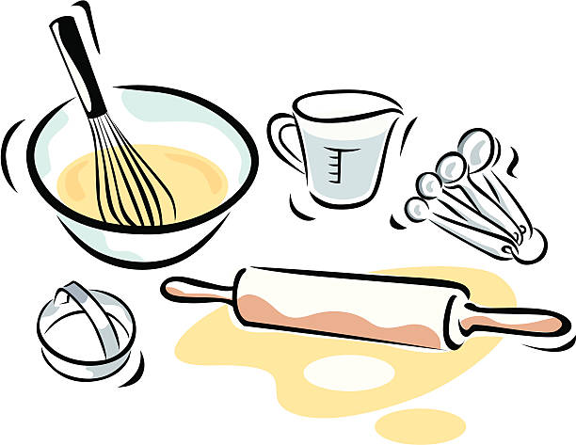
How much is one third of the recipe ?
A pan cake recipe calls for
3 cups of milk
240g of butter
5 cups of flour
2 cups of sugar
6 eggs
1 teaspoon of vanilla
3 teaspoon of baking powder

Slide 34
Fraction of a fraction
02

Slide 35
What is a half of a half?
$$\frac{1}{2}$$

Slide 36
What is a half of a half?
$$\frac{1}{2}$$
$$× \frac{1}{2}$$
$$= \frac{1}{4}$$

Slide 37
What is a third of a half?
$$\frac{1}{2}$$

Slide 38
What is a half of a third?
$$\frac{1}{2}$$
$$× \frac{1}{3}$$
$$= \frac{1}{6}$$

Slide 39
What is a half of a third?
$$\frac{1}{2}$$
$$× \frac{1}{3}$$
$$= \frac{1}{6}$$

Slide 40
What is a half of two thirds?

Slide 41
What is a half of two thirds?
$$\frac{2}{3}$$
$$× \frac{1}{2}$$
$$= \frac{2}{6}$$

Slide 42
What is a half of two thirds?
$$\frac{2}{3}$$
$$× \frac{1}{2}$$
$$= \frac{2}{6}$$

Slide 43
Simplify the answer
2
1
2
÷2
1
×
=
=
3
2
6
÷2
3

Slide 44
We can do it in another way
2
1
2
÷2
1
×
=
=
3
2
6
÷2
3
2
1
×
3
2

Slide 45
Switch denominators
2
1
2
÷2
1
×
=
=
3
2
6
÷2
3
2
1
1
×
=
2
3
3

Slide 46
Multiply this fraction
9
2
18
÷6
3
×
=
=
10
3
30
÷6
5

Slide 47
In multiplication, we can simplify before we multiply
9
2
18
÷6
3
×
=
=
10
3
30
÷6
5

Slide 48
In multiplication, we can simplify before we multiply
3
1
9
÷3
2
÷2
3
×
=
3
÷3
10
÷2
5
1
5

